Slide 1
Why blog?
Create classroom discussions
Learn Digital Citizenship
Practice Writing Skills
Create an e-portfolio
Reflect on learning

Slide 2
What does it look like?
http://disney21.weebly.com/1/post/2013/04/after-using-the-ipad-for-a-few-months-now-please-tell-me-what-your-favorite-app-is-and-how-this-has-helped-you-in-school.html#comments

Slide 3
Writing a good blog comment

Slide 4
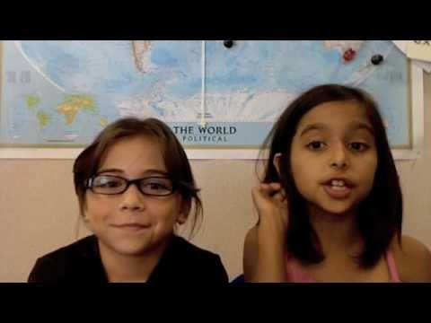

Slide 5
Content
Give specific details
Comment about something specifically: That reminded me of…, I like when you talked about…, That reminds me of a time when…
Instead of: cool, that’s great, I agree

Slide 6
Content
Don’t repeat yourself, add new information
If it has already been said, try and add some new factual information to your comment.
“ I like screenchomp too, if you click on the record button, you can add your voice to your drawing.”

Slide 7
Content
Add information
Sara,
I like how you mentioned how Michigan became a state, we were the 26th state to enter the union.
Tim

Slide 8
Content
Give a compliment
Sara,
I really thought you did a good job on giving us the details on what the people of Michigan had to do to become a state.
Tim

Slide 9
Content
Ask a question
Sara,
Thanks for the information on Michigan becoming a state, but do you know who the first governor was?
Tim

Slide 10
Content
Make a connection
If you are commenting on a blog about a camping trip, (and you have been on one), make a connection and talk about some info on your camping experience.

Slide 11
Content
Answer a question/respond to a statement
Give specific details
Don’t repeat, add new information
Give a compliment
Ask a question
Make a connection

Slide 12
The Body
Always have a greeting/closing
Sara,
Thank you for the great article on Michigan.
Tim

Slide 13
Proofread
Always double check:
Spelling
Capitalization
Punctuation
High level vocabulary

Slide 14
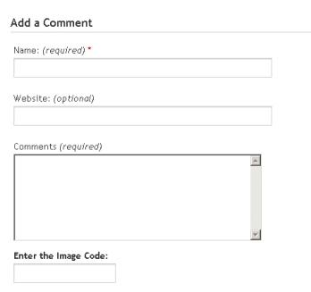
Adding to a weebly blog
Never put your full name

Slide 15
Let’s practice
Go to
disney21.weebly.com
Go to Blog 21 (under the MORE tab)

Slide 16
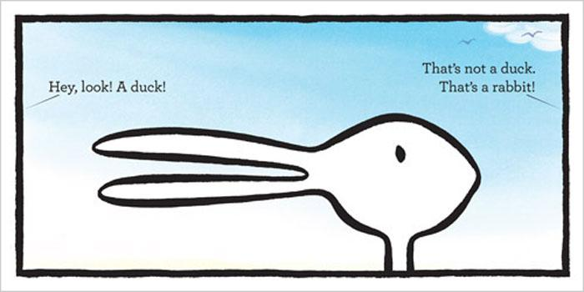
Is this a duck or a rabbit? Why?
Click “Add Comment”

Slide 17
Directions
Respond to the blog
Then reply to at least 2 other classmates

